Slide 1


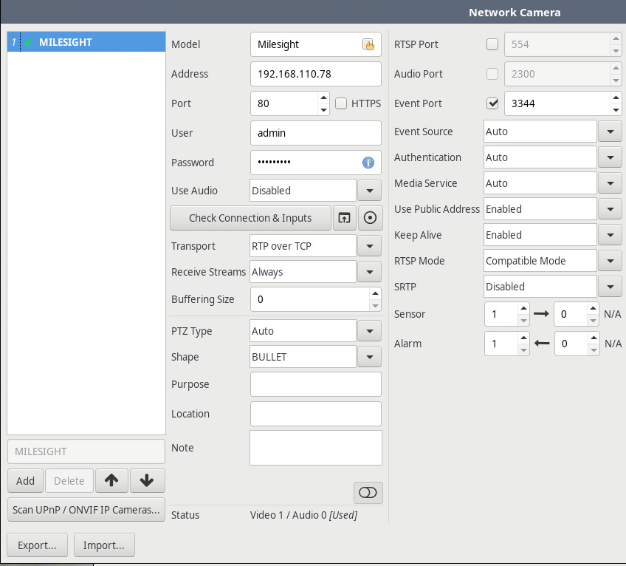

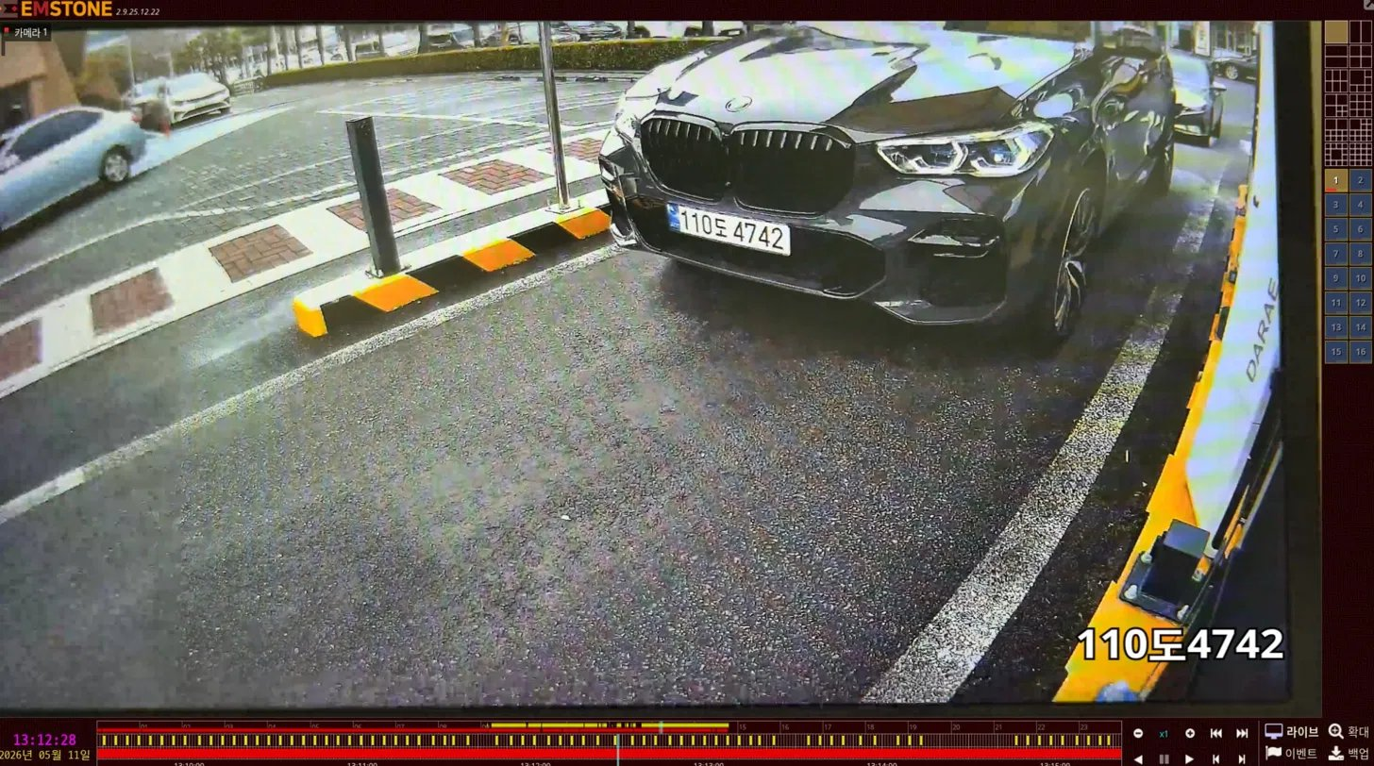
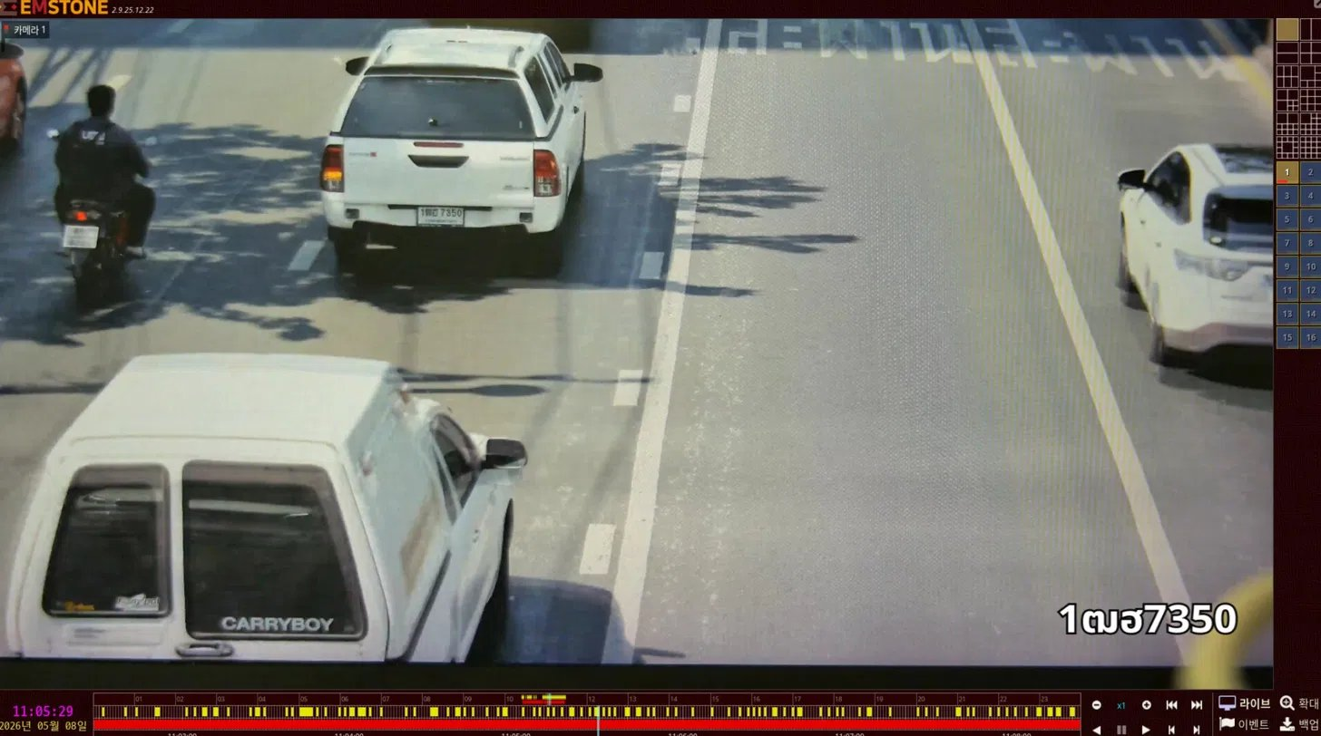
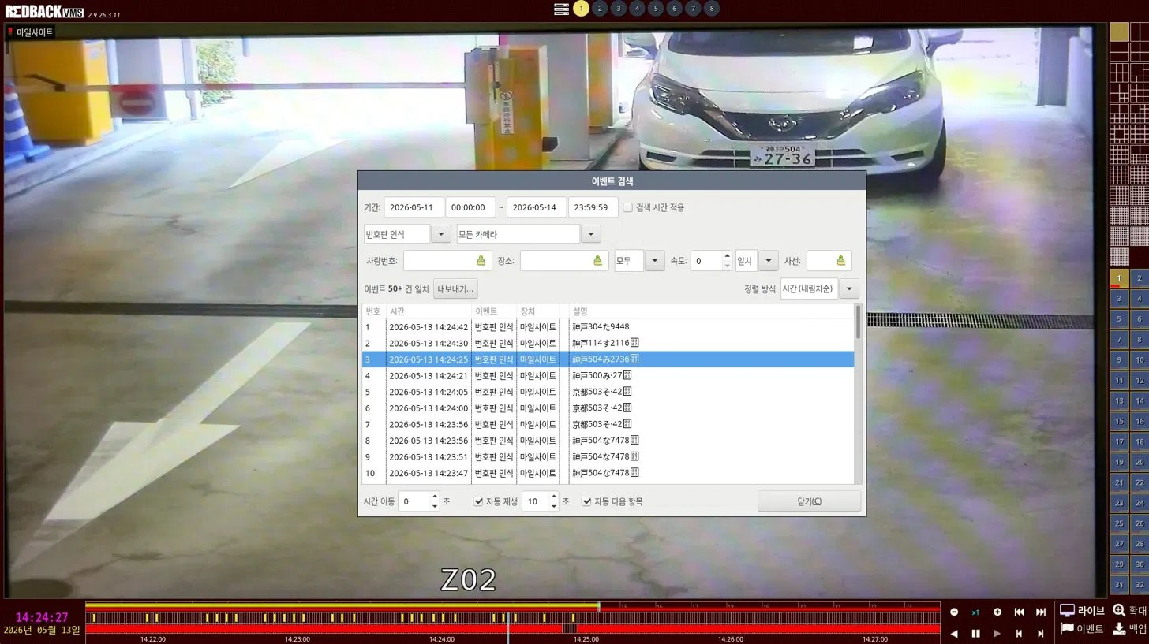
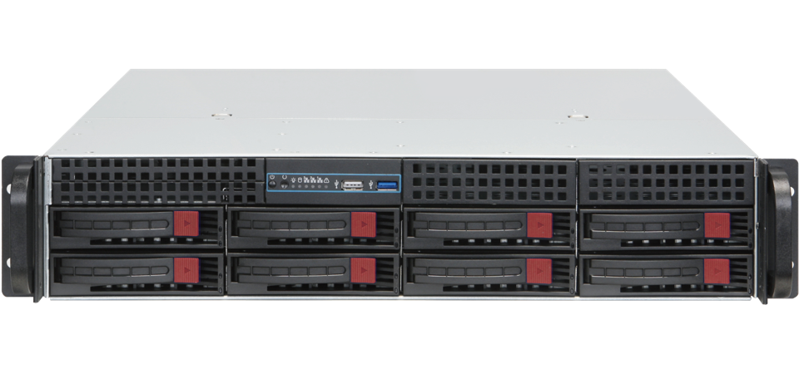
Global LPR,
One Recorder.
— HOW IT CONNECTS
Integration Method
Milesight LPR Cameras + EMSTONE NVR form a complete license-plate recognition pipeline. The camera handles on-device recognition; the NVR records, indexes, and acts on every event — natively, with no extra LPR server or per-plate license.
- Dedicated Milesight protocol
— RECOGNIZED any kind of plate
KR
TH
JP
- NVR camera registration screen
110도 4742
1ฒฮ 7350
神戸 504
LPR
Event
No
No
Yes
Milesight LPR
EMSTONE NVR
LPR server required
Per-plate or cloud fees
Verified field-deployed
ON-EDGE RECOGNITION
VMSB8 / SSB8
Plug-and-play.
- Dedicated Milesight protocol built into
EMSTONE NVR for seamless LPR integration.
- no middleware, no scripting.
✓

Slide 2
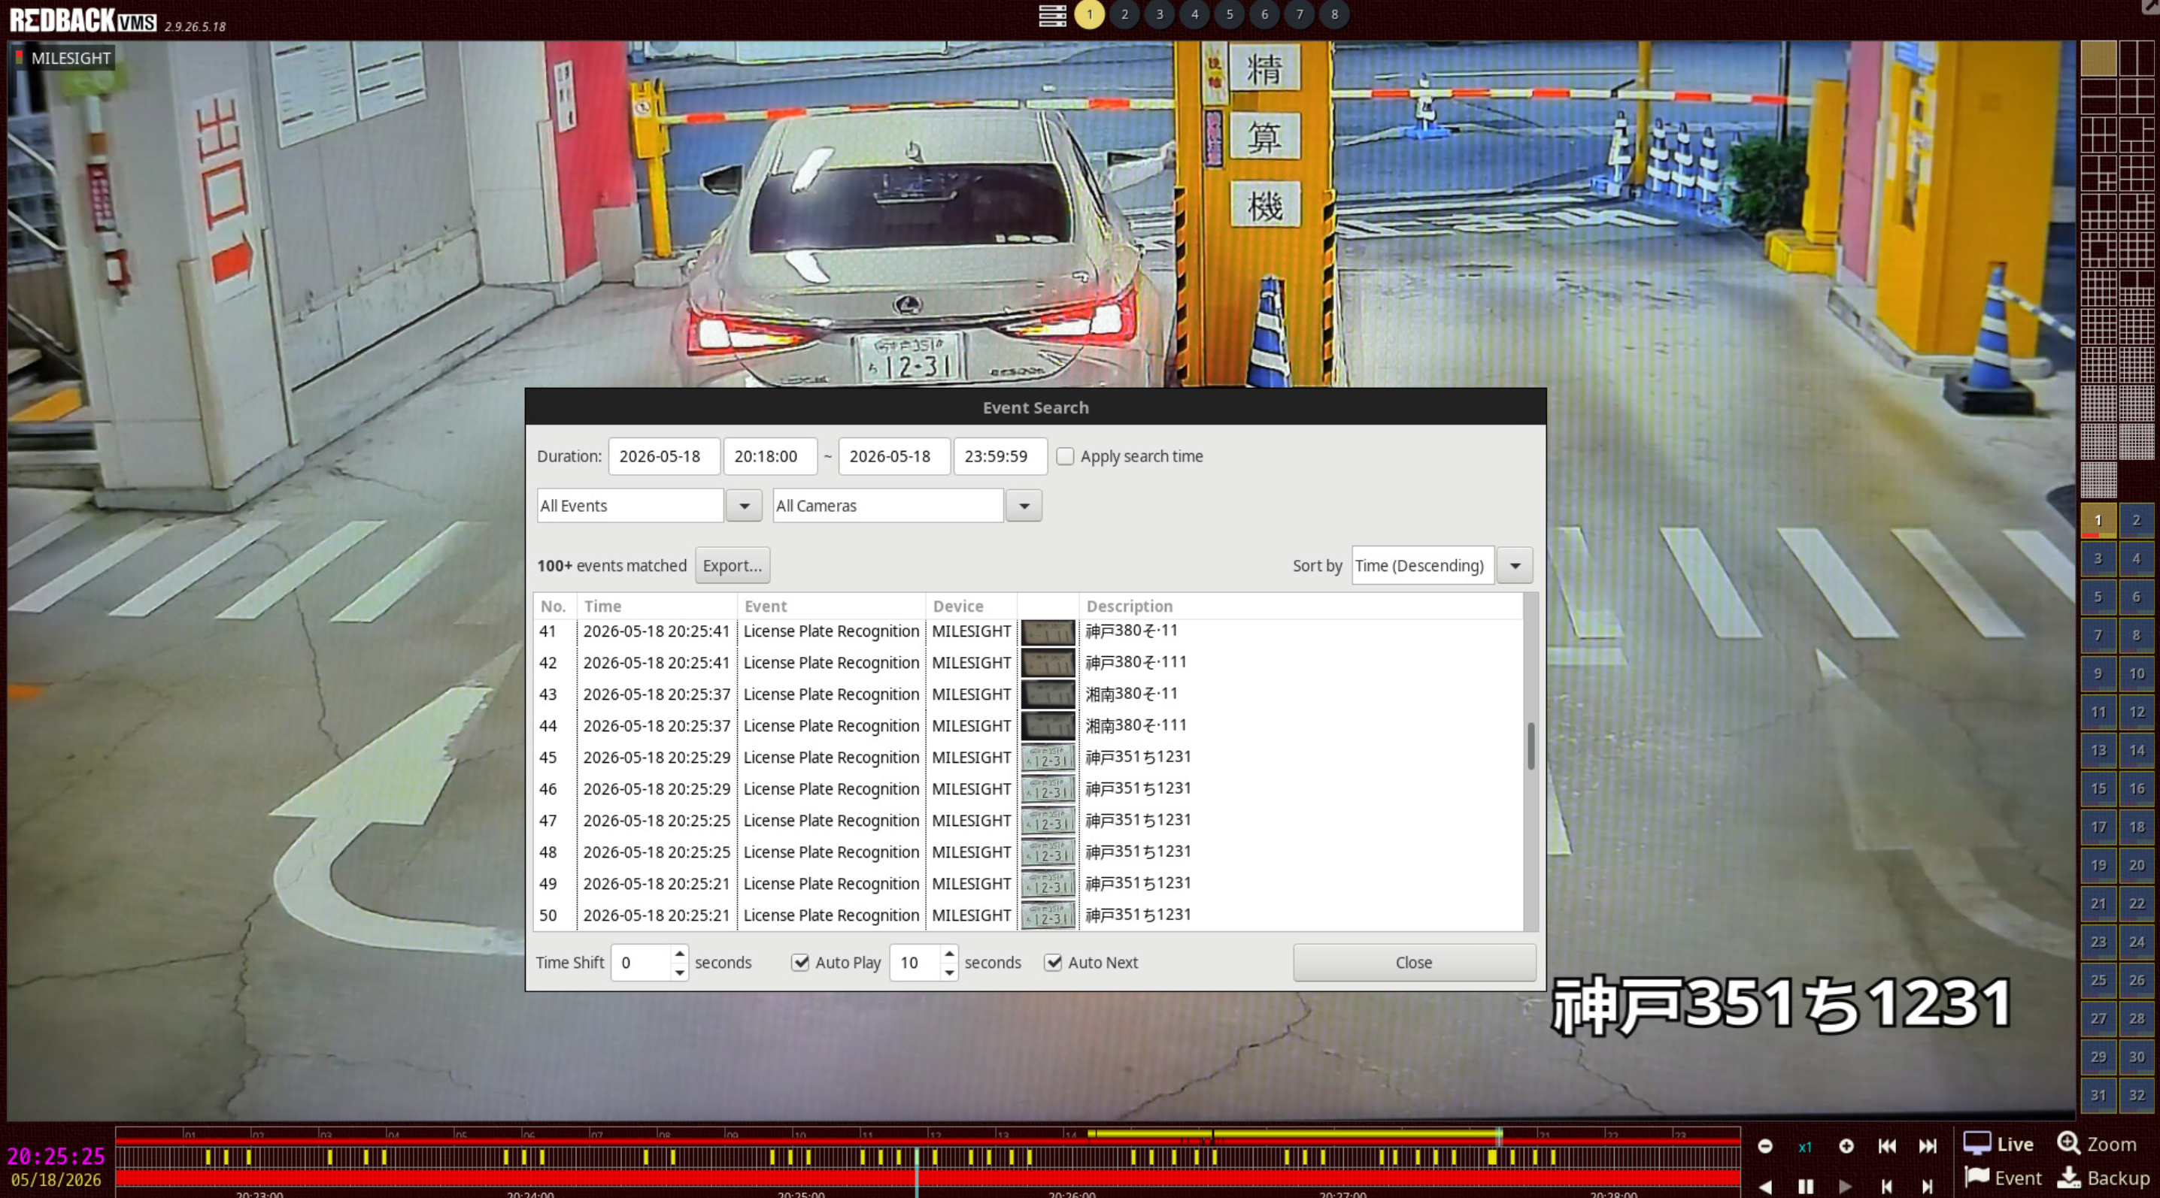
SOLUTION FEATURES
Search. Act. Resolve.
Every recognized plate becomes a searchable, actionable event inside the EMSTONE NVR
and extends to CMS-wide automation for multi-site operations.
— FEATURE 01
— SEARCH WORKFLOW
Event Search & Plate Lookup
Filter by plate number, time range, camera, or location to recall every recognition event
with the matching video clip one click away.
Built directly into the NVR / CMS interface, no external database needed.
CAPTURE
Milesight LPR
Plate recognized at the edge
STORE
EMSTONE NVR
Event + video saved automatically
SEARCH
Filter & Find
By plate, time, camera, or zone
RESOLVE
Export · Share · Act
Evidence ready in one click

Slide 3

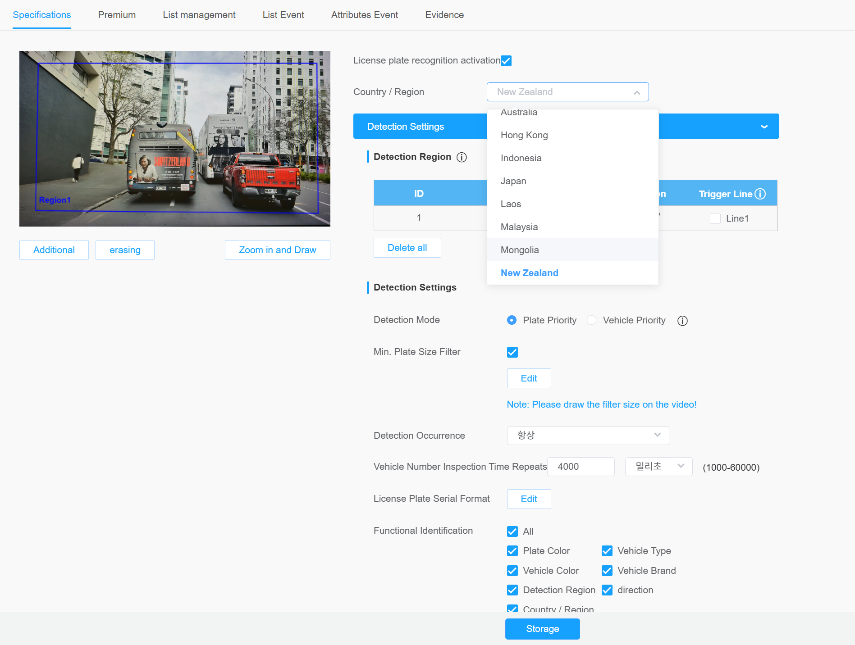

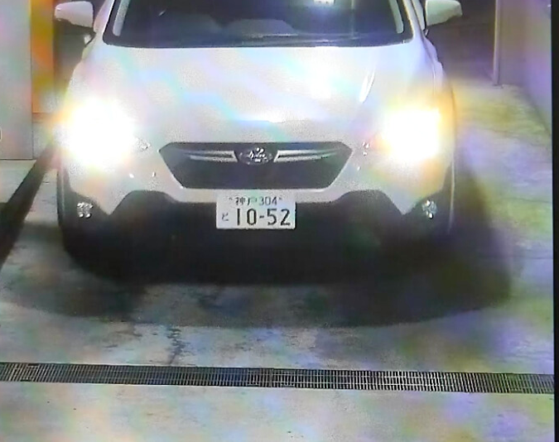


— FEATURE 02
— Multi-script support
Support / Multi language
One search engine. Four writing systems.
Type a full or partial plate string to surface
every appearance across all cameras across days, months, sites.
Multi-script support (Hangul, Latin, Kanji, Thai).
110도4742
NR2640
Hangul
Latin
Korea
EU · US · Global
Korean plates
Roman alphabet
神戸304と1052
1ฒฮ7350
Kanji
Thai
Japan
Thailand
Japanese plates
Thai plates

Slide 4
— FEATURE 03
NVR · CMS Triggered Actions
Turn a recognition event into an operational response — automatically.
— RECOGNITION EVENT
12가 3456
Control Room
NVR/VMS
On site
Pop-up alert on operator
CMS multi-site broadcast
Instant on-screen notification
Event-tagged recording
Push alert across all sites
Bookmark clip with plate metadata
IPWALL screen switch
Alarm-out · gate control
Auto-route plate view to wall display
Open barrier or relay output

