Slide 1



Make Sensing Matter
Milesight

Slide 2


CONTENTS
01 About Milesight
02 Milesight & Milestone: Seamless Integration
03 Featured Solutions
04 Incentive Program
Make Sensing Matter
Notes:
Who is Milesight? → What do you provide?→ How well do you actually work with Milestone? → What extra value do I get? → Where could I use this combination? → Why should I actually try it?

Slide 3


01 About Milesight
Make Sensing Matter

Slide 4












About Milesight
Strong In-House R&D
Milesight is a global manufacturer of multi-potential sensing products, capturing meaningful data and transforming it into actionable intelligence. By integrating AI, 5G, and IoT, we empower industries to boost automation, improve efficiency, and make smarter decisions.
50%+ of employees dedicated to R&D
Rapid response to evolving project needs
Advanced Edge AI capabilities
Beyond Video: Multi-Dimensional Sensing
2000+
Bringing video and IoT sensing together for broader visibility and actionable insights
Distributors and System Integrator Partners
79%+
Video Surveilliance
Profit Reinvest in R&D
+
Smart IoT
Global Reach. Trusted by Design.
30%+
Built for global project and security requirements
CAGR from 2023 to 2025
1000+
120+
Employees
Make Sensing Matter
Countries and Regions
Notes:
公司定位 + 核心价值，包装成一个技术导向型的公司
重研发：超过50%的员工为研发人员，近三年研发投入占利润总额的79%. 体现重研发投入
CAGR iot + 安防实际：28.66%，可否写到30 或 35%

Slide 5
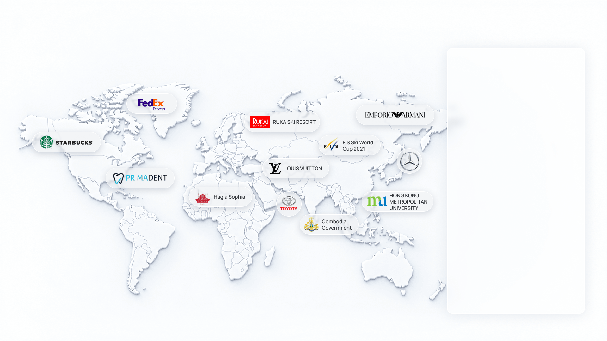
Trusted Worldwide
Commercial & Retail
Banking
Government
Education
Hospitality
Industrial
Health Care
Energy
Traffic & Transportation
Parking Management
Logistics
Smart City
Make Sensing Matter
Notes:
体现全球性，覆盖面广，成功部署多个行业，知名终端。这页业务可以按需使用。
由于目前知名案例及终端的数量确实较少，这页需考虑是否还需添加，目前看来并不是非常convincing，建议可以在公司介绍的时候往我们覆盖的industries/verticals的丰富性上讲。
有的终端不能公开展示，业务私下present应该没问题

Slide 6




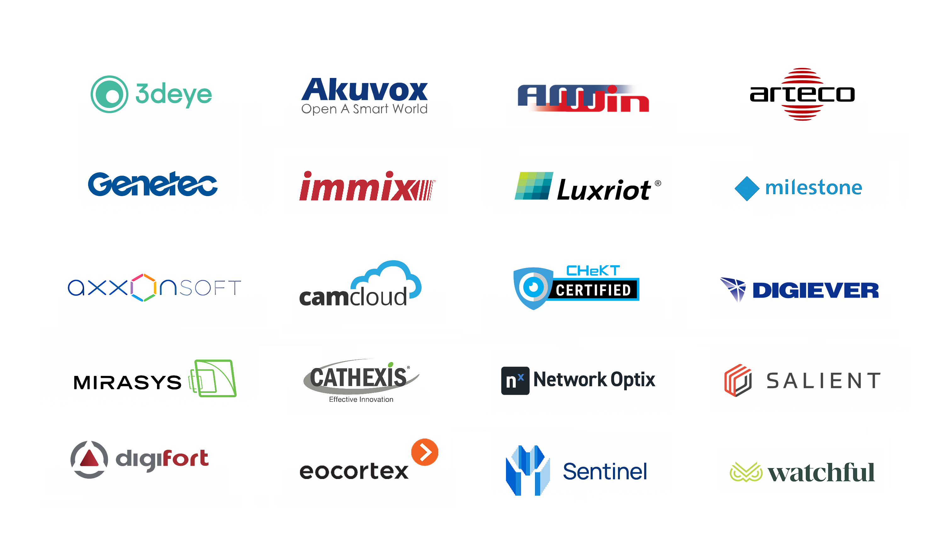



Built for an Open Ecosystem
Milesight focuses exclusively on front-end innovation, backed by dedicated R&D and interoperability validation to deliver deeper ecosystem compatibility, scalable integration, and greater deployment flexibility across evolving security platforms.
Full Function Compatibility
Camera Analytics Full Leveraging
Project-Driven Application Development
Driver
Milesight-Developed Plugin
More...
Standards-Based Compatibility
Platform-Specific Integration
G
M
S
T
V
One API
Profile M for Metadata
Expanding Profile Support
Cross-Product Consistency
Make Sensing Matter
Notes:
公司生态战略：
第一层：MS不做自己的vms，而是更专注前端硬件与AI的能力，通过开放生态去适配不同平台与解决方案，从而更好的服务客户。
第二层：如何系统化地实现和落地这个战略？
ONVIF标准协议接口：解决行业标准互通、基础兼容、长期稳定性。（可根据受众补充：MS作为onvif成员，持续跟随 ONVIF profile 演进，并通过模块化协议架构，保证长期兼容稳定性。）
私有协议接口：根据不同平台深度集成的不同层级。比如说我们有API (MS 在产品的底层接口保持一致性，让生态伙伴更容易开发、更容易维护、更容易扩展)
通过Milesight和平台双方的研发协作，最终的兼容 & 开发的成果：driver，plugin，and more....
第三层（重点）：最终创造的价值，这里应该才是SI会关心的点“给我创造什么价值？”
Full Function Compatibility：对客户来说，不仅仅是“能接上”，而是尽可能释放平台与相机双方的功能能力，实现更深层、更完整的系统协同。
Camera Analytics Leveraging: 相机侧的 AI 能力、Metadata 和 Analytics 不只是停留在设备端，而是真正能够在平台侧被调用、展示、检索和利用。
Project- Driven Application Development：不仅满足标准功能需求，还能围绕具体项目场景持续创造新的业务价值。（例如数据可视化dashboard等）

Slide 7









Built to Support Your Business
Win More Projects. Deliver with Confidence. Grow Together.
Sales
Technical: Pre- sales
Marketing
Demo Support
Product & Solution Training
Case Study Development
Product evaluation, PoC testing & pilot deployments
Product selection, applications & Milestone integration
Amplify successful projects across Milesight’s global marketing channels
Project Design & Customization
Project Registration &
Special Pricing
Engineering support for solution design & project-specific requirements
Marketing Assets
Ready-to-use product and solution materials for sales & customer engagement
Opportunity protection & tailored pricing for competitive project bids
Technical: Post- sales
Sales SPIFF Incentives
Dedicated Technical Support
Direct rewards for reps on eligible Milesight product sales
Direct access for faster issue resolution
On--Site Project Support
Available for qualified strategic projects upon request
Make Sensing Matter
Notes:
SI 激励政策，作为一个概览，在公司介绍部分体现我们的支持。后续具体细节可以放到最后incentive program，根据具体SI客户和区域制定更细的激励内容，如数字等

Slide 8



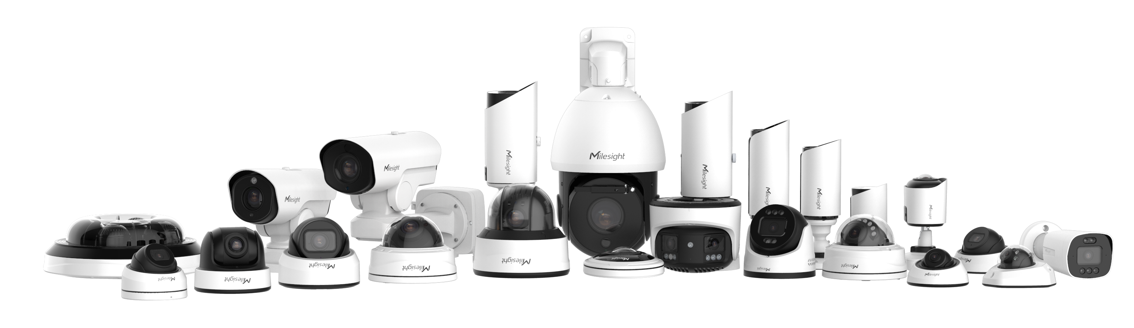
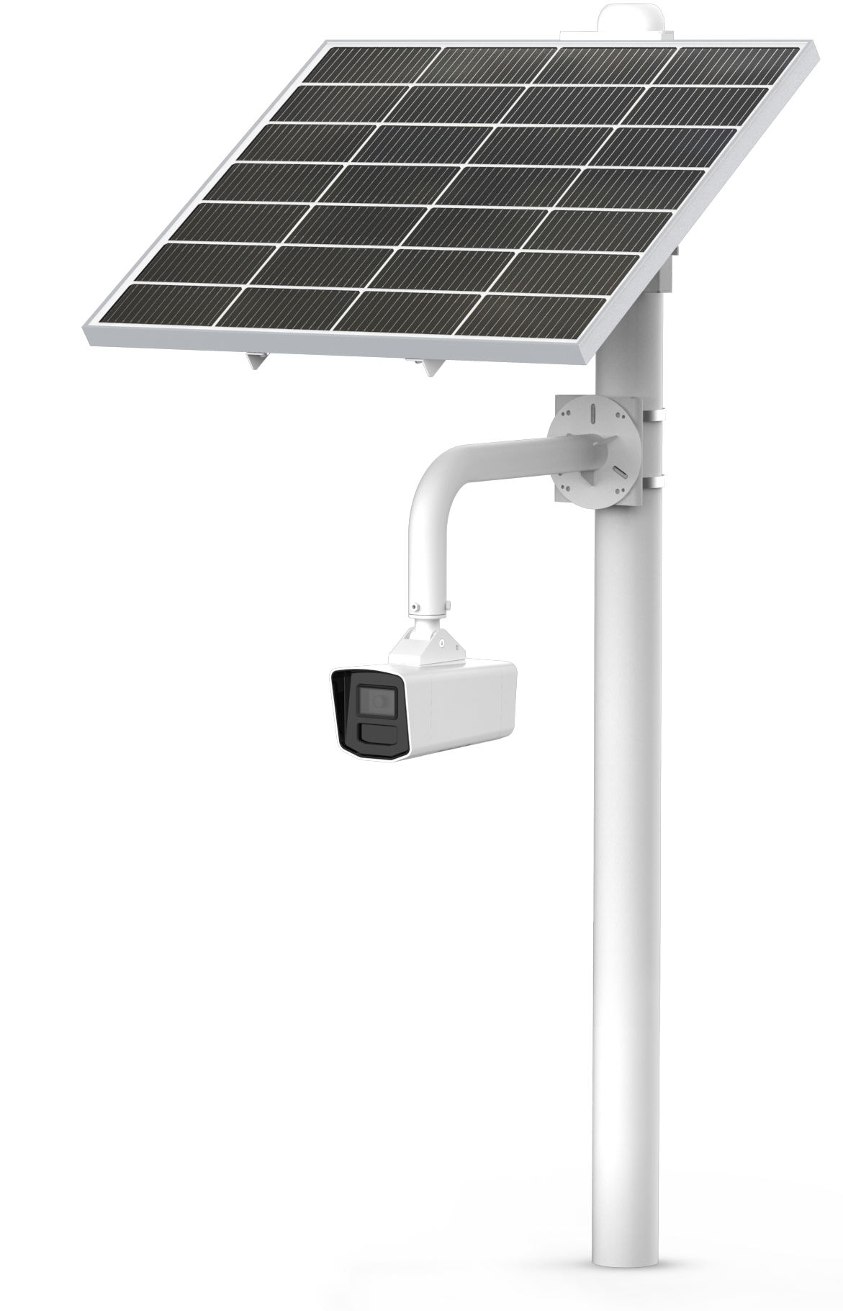

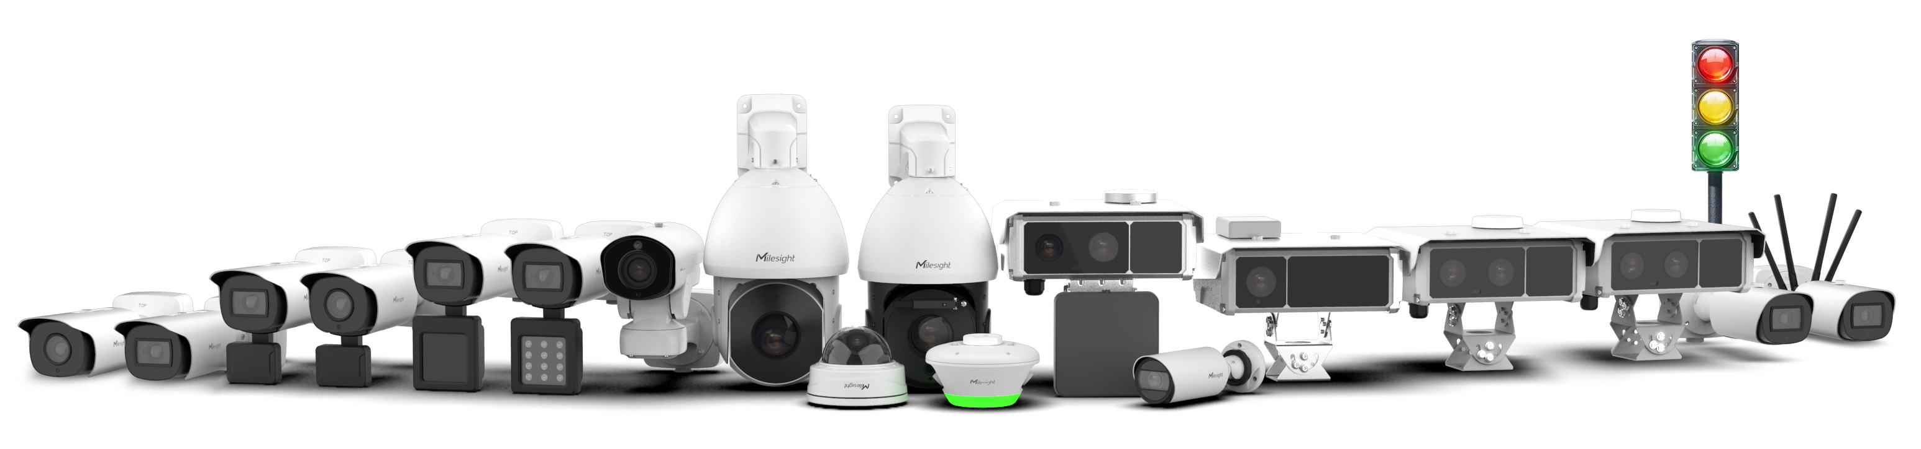
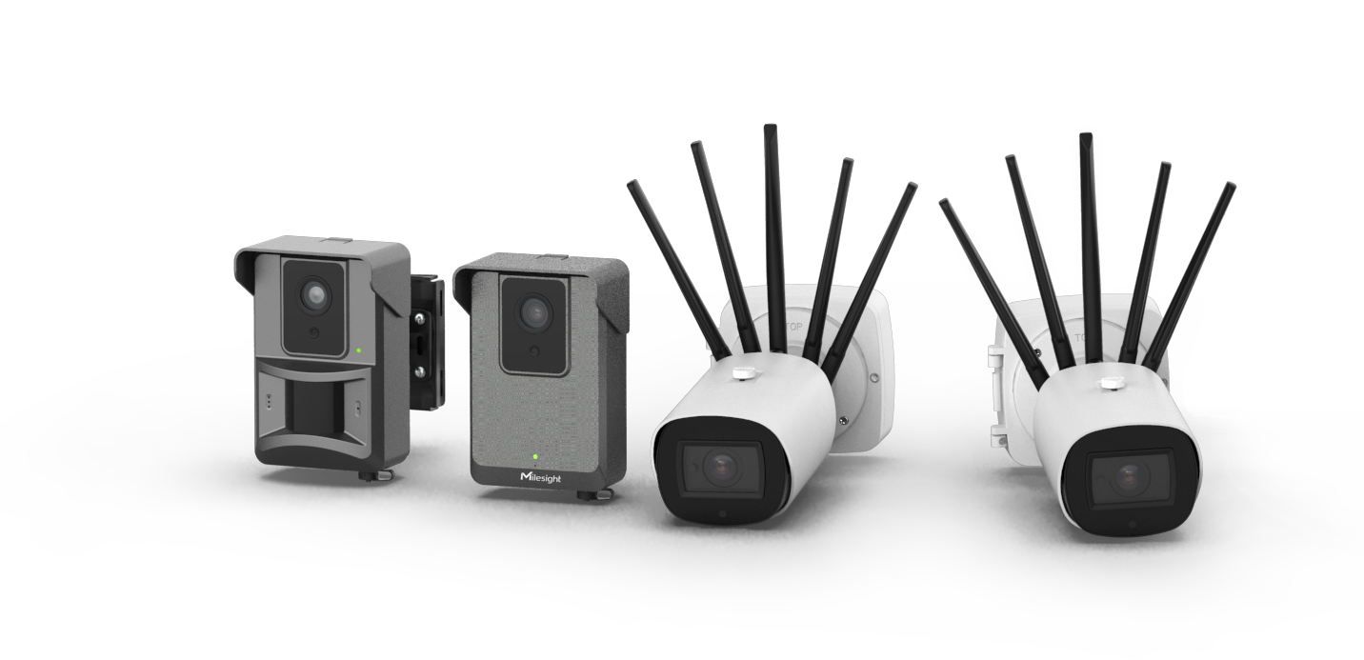
Milesight Product Portfolio
Breadth, Differentiation, and Specialization
Video Surveillance
A full-spectrum AI camera lineup — from compact to professional — built for diverse scenarios, powered by Edge AI analytics and exceptional image quality.
Outdoor Wireless
Intelligent Traffic
Truly off-grid surveillance with all-in-one kit — no power, no network, no problem.
Empowering intelligent mobility — with advanced solutions for Road Traffic and Parking Management across every environment.
Make Sensing Matter
Notes:
产品线，要让 SI 感受到 breadth + differentiation

Slide 9
02 Milesight & Milestone: Seamless Integration
Make Sensing Matter
Notes:
怎么兼容 → basic functionality → deeper capabilities → Easy to Deploy & Manage：功能很多，但 SI 使用成本不高

Slide 10
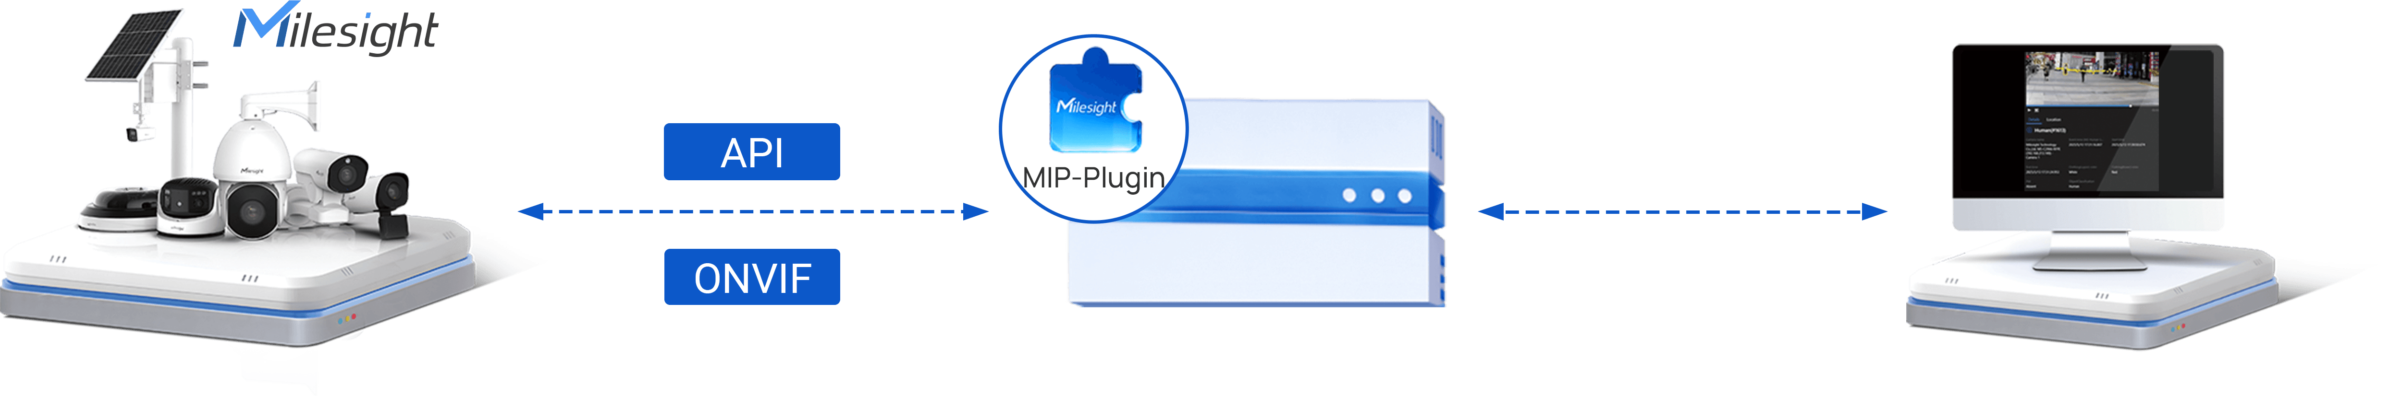


Integration Overview
Milesight Cameras
Milestone Server
Milestone XProtect
ONVIF Driver
Self-Developed Plugin
Profile G/M/S/T Conformity
Video / Two-way Audio / PTZ Control
I/O Linkage / Edge Recording / Event Management
Advanced Utilization of Milesight AI
Faster Camera-to-VMS Data Sync
Flexible Customization for Project-Specific Needs
Make Sensing Matter
Notes:
这页理解为一个概览，底层有onvif去支撑所有的基础功能比如说相机配置，events， metadata，和 video streaming， 对于一些需求更高的项目我们有自研的插件，能把更高端的功能带入，比如更丰富的ai， 属性搜索，然后简易部署配置

Slide 11





























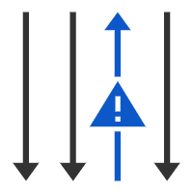










Full AI Compatibility: Events & Attributes
Advanced Object Search
Support All Video Surveillance & Traffic Edge Metadata
Trend Analytics
Behavior & Safety Analytics
Customized Search Filters
People Counting
PPE Detection
Vehicle Counting
Fall Detection
Heat Map
Violence Detection
Traffic Event
Traffic Evet
Attribute Events
Vehicle Behaviors
Access Controls
LPR Event
Reverse Driving
Black List Event
License Plate Attribute Recognition
Vehicle Attribute Recognition
No Plate Event
Speed Detection
White List Event
Number/Type/Color/
Country
Type/Color/Brand
...
Vehicle Attribute Event
Visitor List Event
Make Sensing Matter
Notes:
第二页相当于更深一步，可以分为两个层级去介绍，第一个层级是所有的events，同时还有一些traffic 的事件，讲稿的时候可以提一下这部分是通过onvif来做
第二部分是我们所有的属性都可以被带入到milestone里面，去进行人车衣这些属性方便快速检索，这部分通过ms插件来做

Slide 12


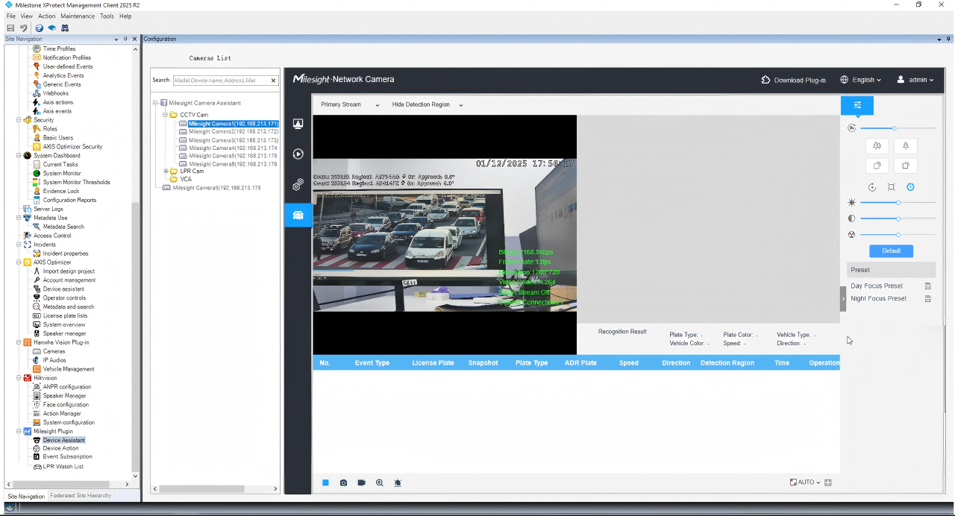
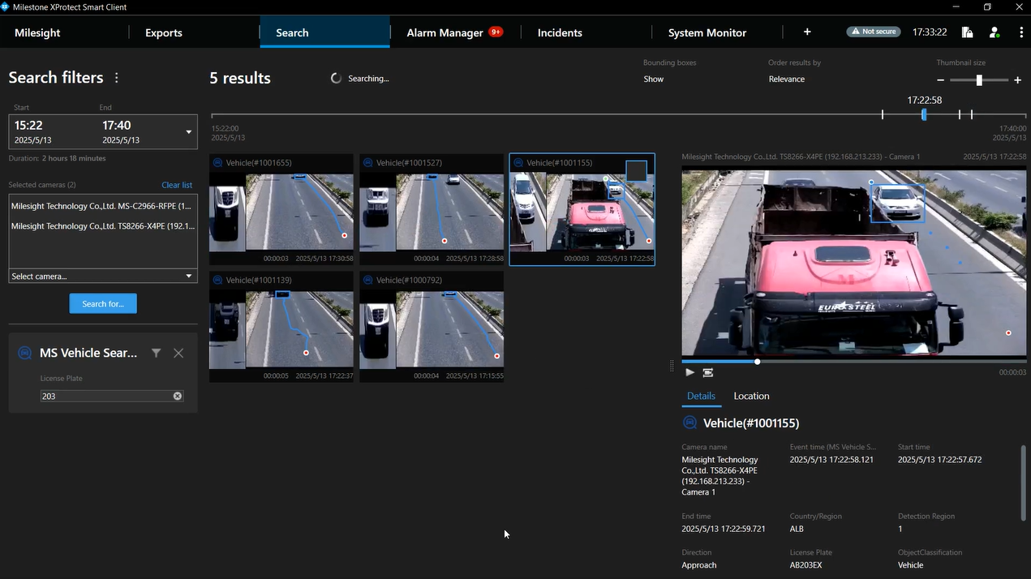
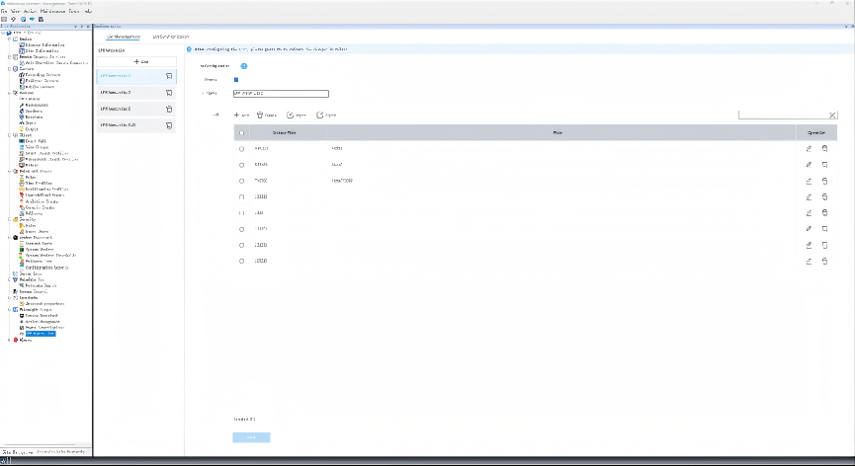

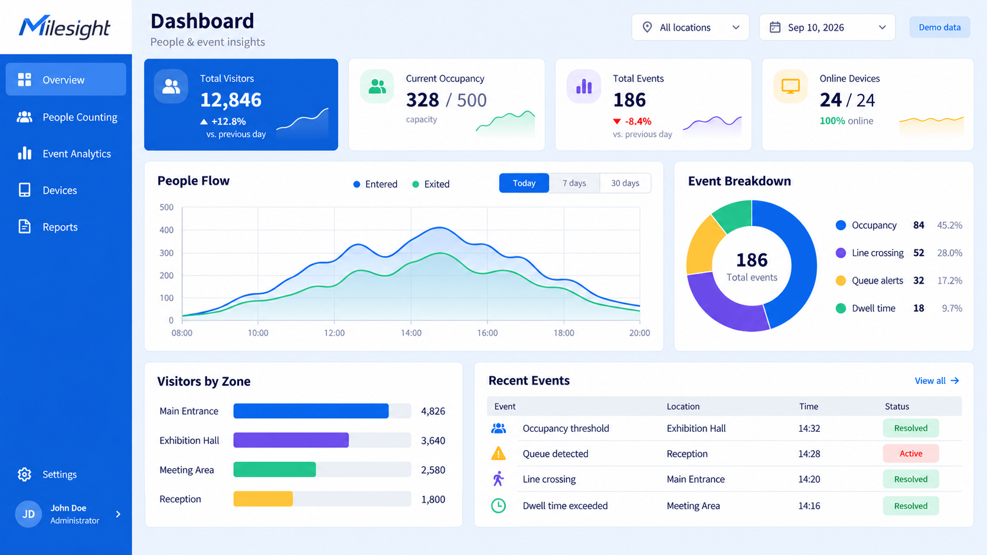

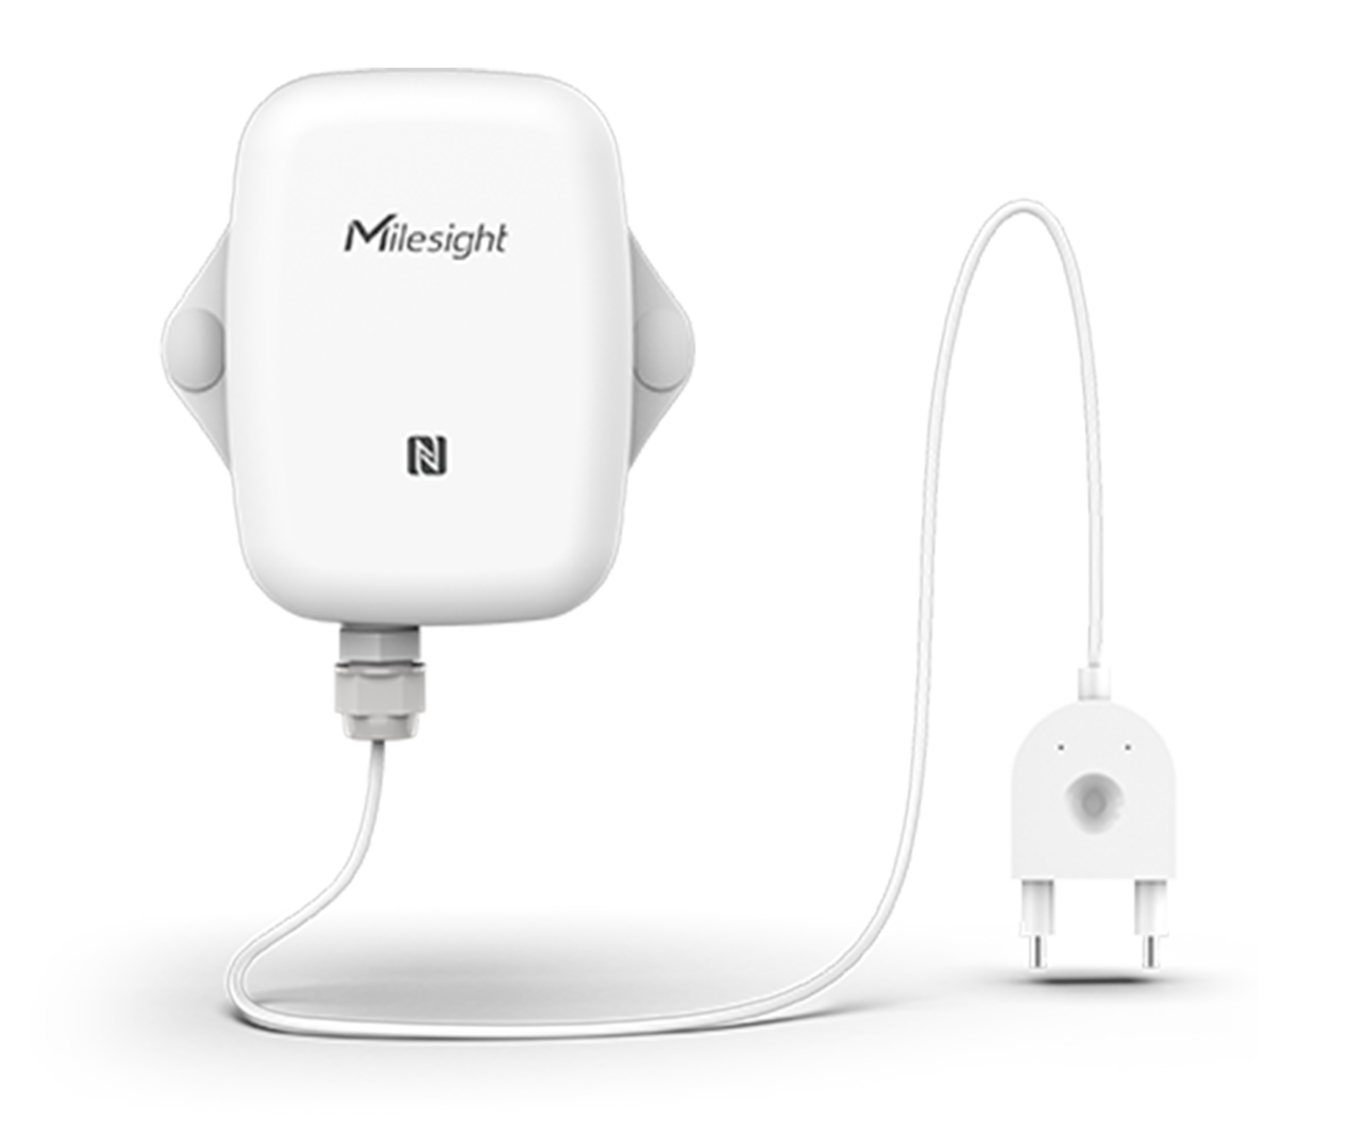


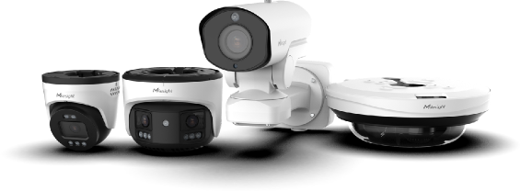
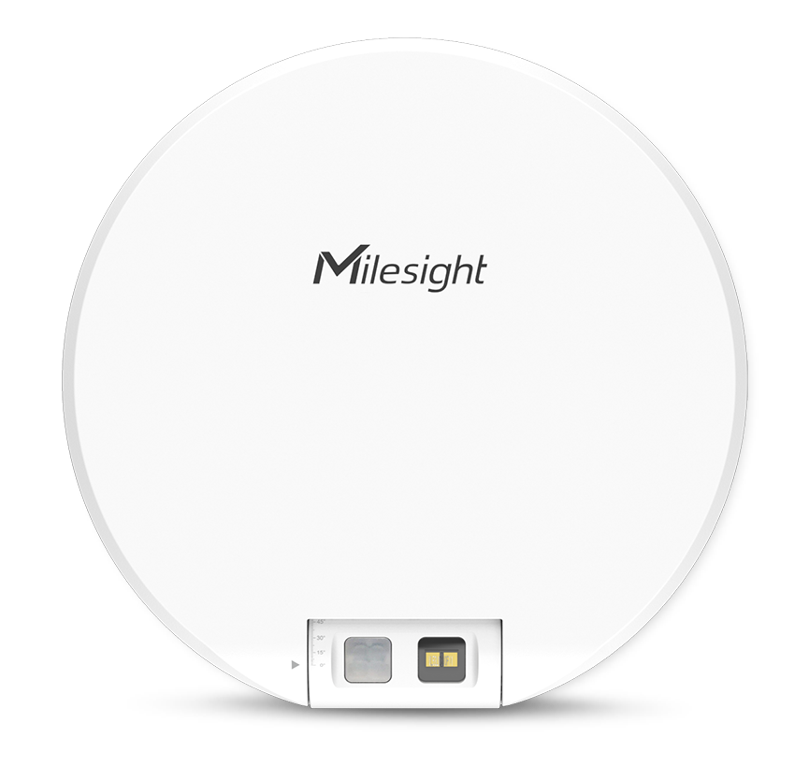
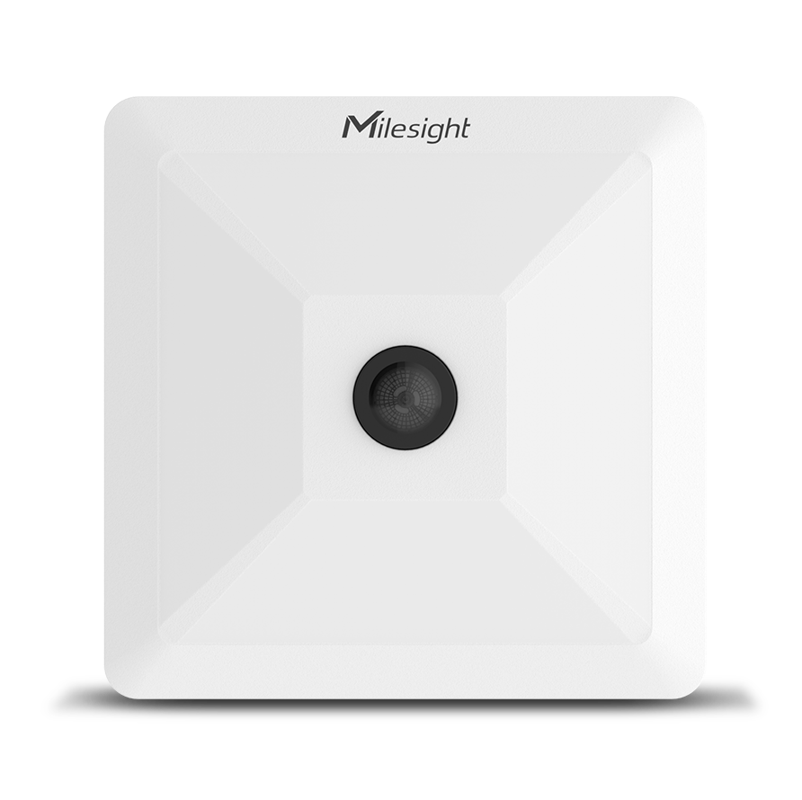
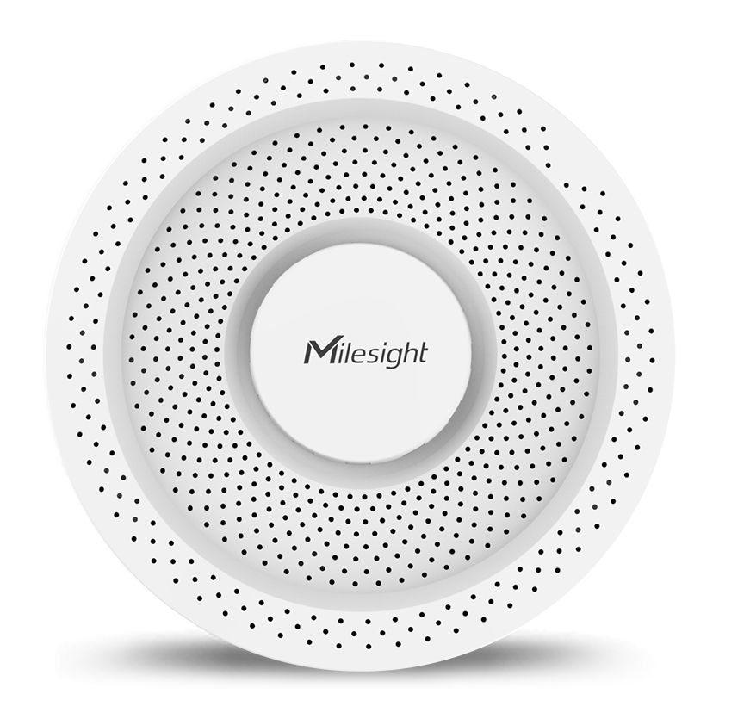
Ease of Use
[
[
[
Simplified Configuration
Centralized Maintenance
Actionable Application
Credential-free Camera Access
Action Mangement for Flexible and Intuitive Action Linkage
Batch Event Subscription
Milesight Fisheye Dewarping
Centralized Watchist Management and Event Triggering
Smart Search Leveraging Camera Metadata
Milesight Camera View
Centralized Firmware Management
?
Milesight Dashboard
IoT Data Integration
What's Next
Notes:
第三页是类似一个总结和升华，前面讲了这么多功能，但 SI 使用成本不高，以及这也是我们和其他竞品做的不一样的地方，这个可以在讲稿的时候特别口头强调一下，就不放到ppt文字里。易用性主要是考虑到如果在管理large sites的时候，通常一个个手动配置会消耗大量不必要的时间，那我们在易用性和简易部署上做了强化，比如相机免密登录，批量管理事件，以及黑白名单的下发。 又或者是在相机固件升级的时候都可以在milestone里统一管理处理，大大节省了时间。这些功能也都是通过插件完成。
roadmap：我们不止停留在相机兼容，下一步会做milesight的dashboard，把我们counting类的数据做一些可视化呈现和总结分析，比如给retail和traffic 分析可以用。
第二个就是 sensor这些多维感知的数据和相机整合联动，并统一带入到milestone 里，这里可以在讲的时候举一个例子比如说 漏水检测/烟雾检测感应到有事件报警之后，可以camera linkage，联动PTZ相机去zoom in和记录等等。
易用性（亮点）
One more thing that becomes really important as a project gets bigger is ease of management.
If you only have a few cameras, managing them one by one may not be a big deal. But once you get to hundreds, or even thousands of cameras, every extra step starts to add up.
So with our Milestone plugin, we try to remove as many of those extra steps as possible.
For example, you can access the camera directly from Milestone without having to log in again with the camera credentials. You can also subscribe to events in batches instead of setting them up camera by camera.
And when it comes to maintenance, things like firmware updates can also be handled centrally. So instead of going through hundreds of cameras individually, you can manage much more of the system from one place.
It may sound like a small difference, but at scale, it can save a huge amount of time.
新增IOT整合
One of the areas we’re really excited about moving forward is bringing Milesight IoT into the same ecosystem.
As I mentioned earlier, IoT is already an important part of the Milesight portfolio. We have different types of sensors, such as vape sensors, occupancy sensors, water leak sensors, and many others. And what we’re working toward is connecting that sensor data with our cameras and bringing the whole workflow into Milestone.
Just imagine a simple example. A water leak sensor detects a leak somewhere on the site. That event comes into Milestone, a nearby PTZ camera automatically turns to that location, the operator receives an alert, and they can immediately see what is happening.
So instead of having cameras here and sensors somewhere else, they can actually work together as one solution.
And that’s really where we see the next step going: not just video management, but bringing video, AI, and IoT data together to create a much more intelligent and automated response workflow inside Milestone.

Slide 13
03 Featured Solutions
Make Sensing Matter
Notes:
“场景痛点 → MS提供的方案 → Milestone统一承载管理”
始终从SI实际的业务价值而非产品亮点或者参数角度展开。整体目的在让 SI 理解 MS 能为现有 Milestone 项目补充什么能力、解决什么问题，以及带来什么价值。

Slide 14
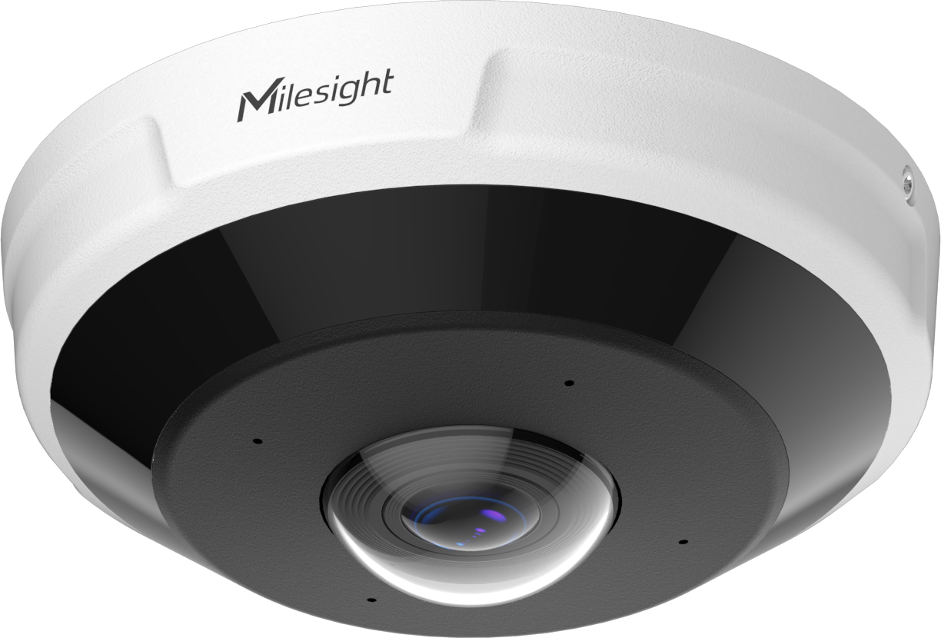




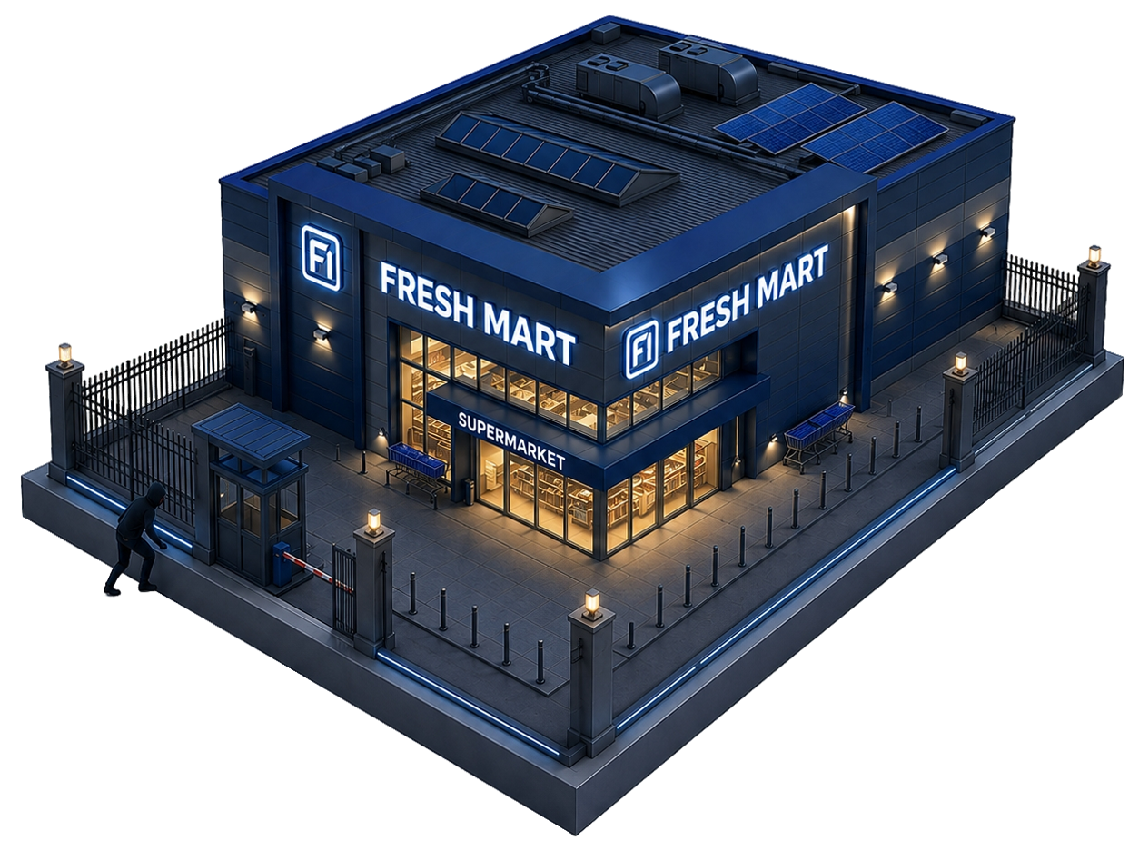
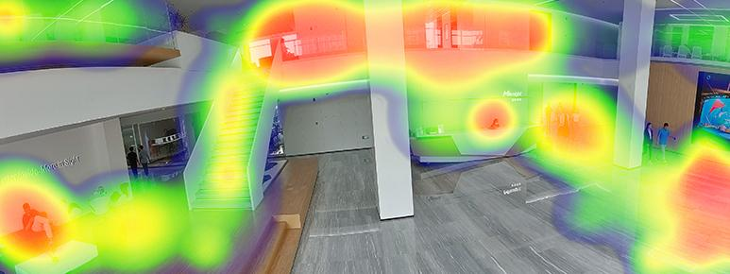
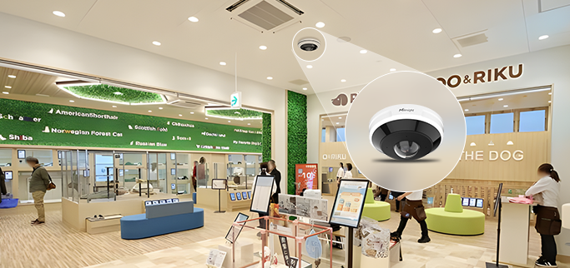
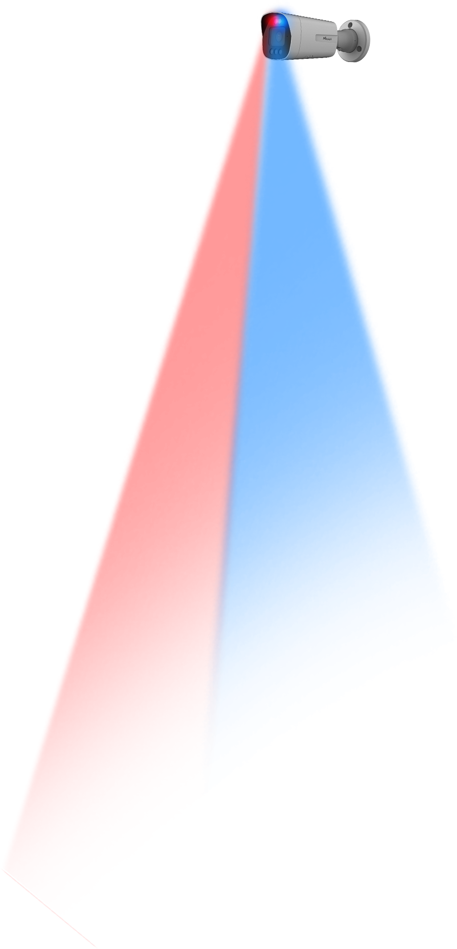



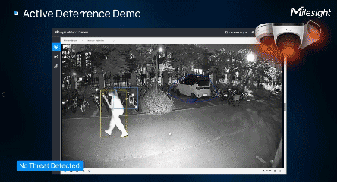

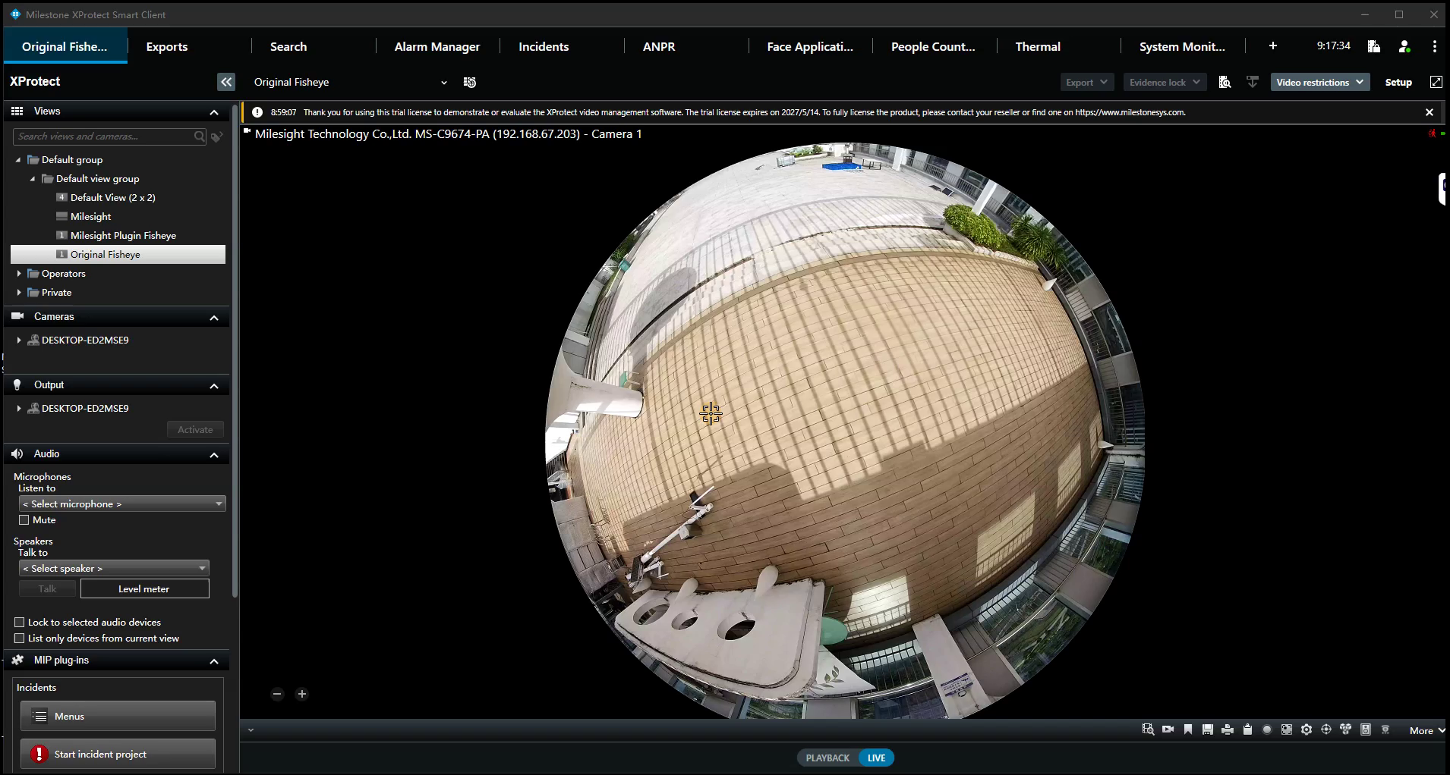
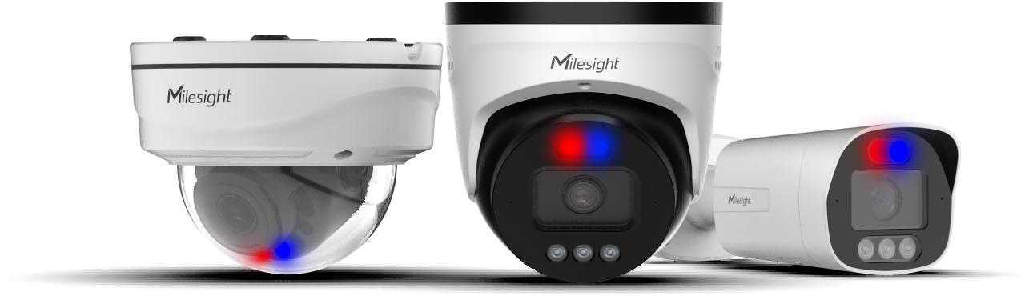

Smarter Security for Commercial & Retail
See More. Understand More.
Challenges
Loss Prevention
24/7 Security
Security efficiency: 360° coverage with fewer blind spots & cameras
Operational Efficiency
Customer Experience
Operational Insights: Reveal traffic patterns & dwell behavior
Business Value: Optimize staffing & space for better customer experience at lower cost
24/7 Proactive Protection
See Clearly: AI ISP & 24/7 TrueColor imaging for critical detail even in low light
Bring It All Together with Milestone XProtect
Detect Accurately: Built-in edge AI for more events, attributes & behaviors with fewer false alarms
One unified interface for video, AI events and alarms
Act Proactively: Red & blue lights + two-way audio to deter threats before they escalate
Turn edge intelligence into faster investigation and response
Manage consistently across cameras, sites & deployments
See Retail Success Story →
Make Sensing Matter
Notes:
- 痛点：不仅只有传统的 Loss Prevention 和 24/7 Security，同时还关注 运营效率和消费者体验。因此，对 SI 来说，项目价值不能停留在“完成视频监控”，而是如何利用同一套视频structure去解决更多终端需求。
- 室外通过Q系列：Go Beyond Passive Monitoring 不仅看的更清晰，还能看的更深和准确，最后主动震慑，层层递进。
- 室内通过 Fisheye：“Turn Video into Actionable Business Insights”. 把摄像机价值从 Security 延伸到 Business Intelligence。
- 最后回到milestone：Milesight 提供丰富的成像、AI 和主动防御能力，Milestone 则将视频、AI Events 和 Alarms 纳入统一工作流，帮助客户更快调查和响应，并能够在更多摄像机、门店和部署中保持一致的管理体验。（如果有更有力的点，可以再补充）

Slide 15
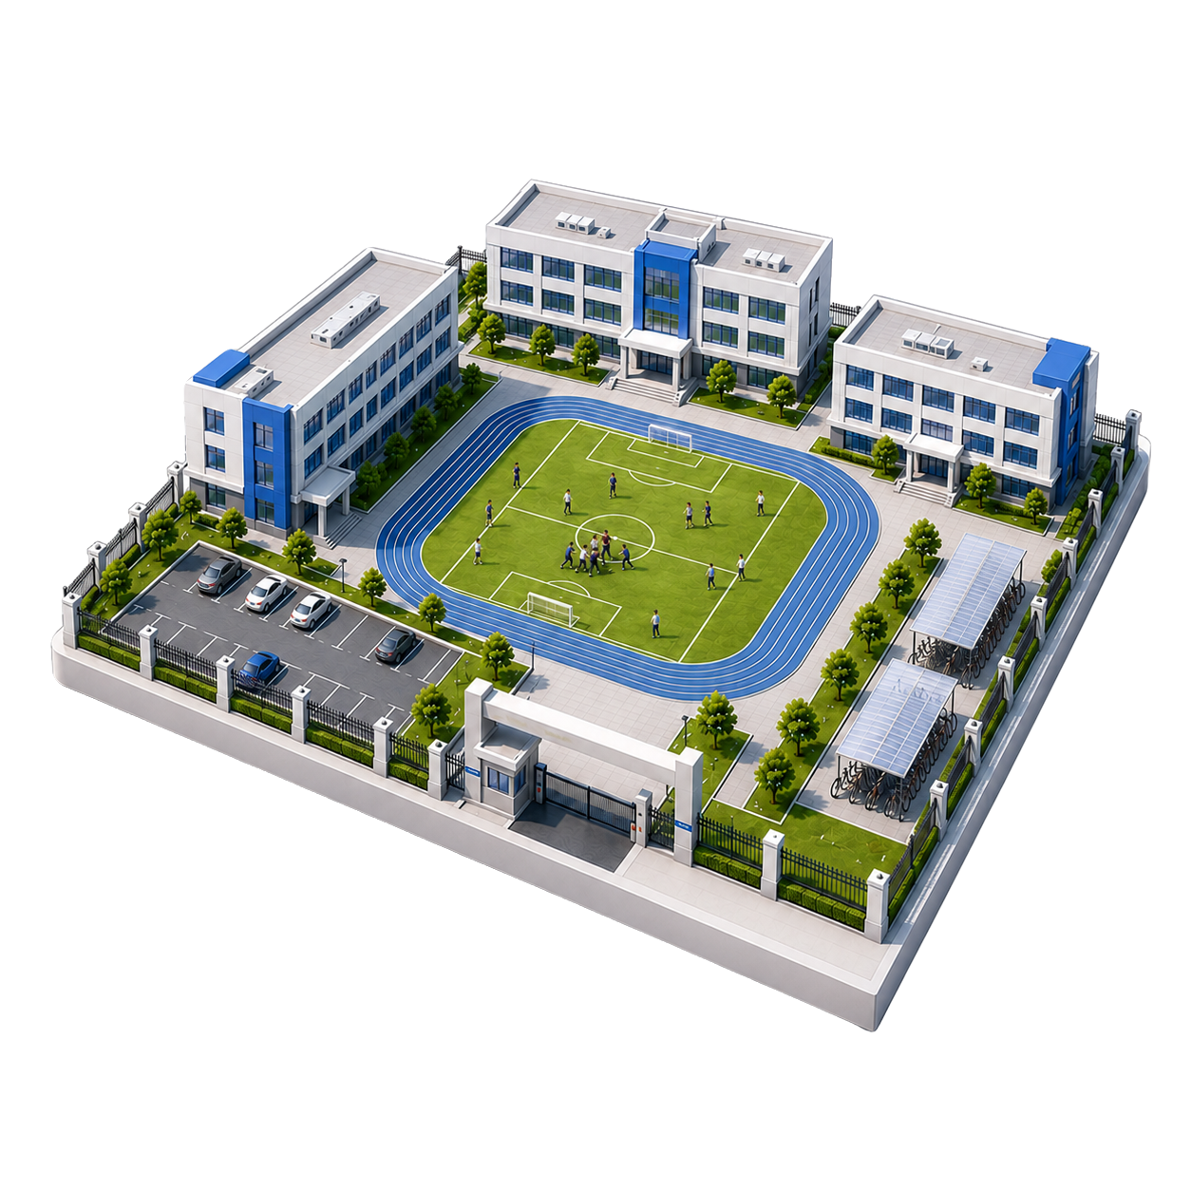
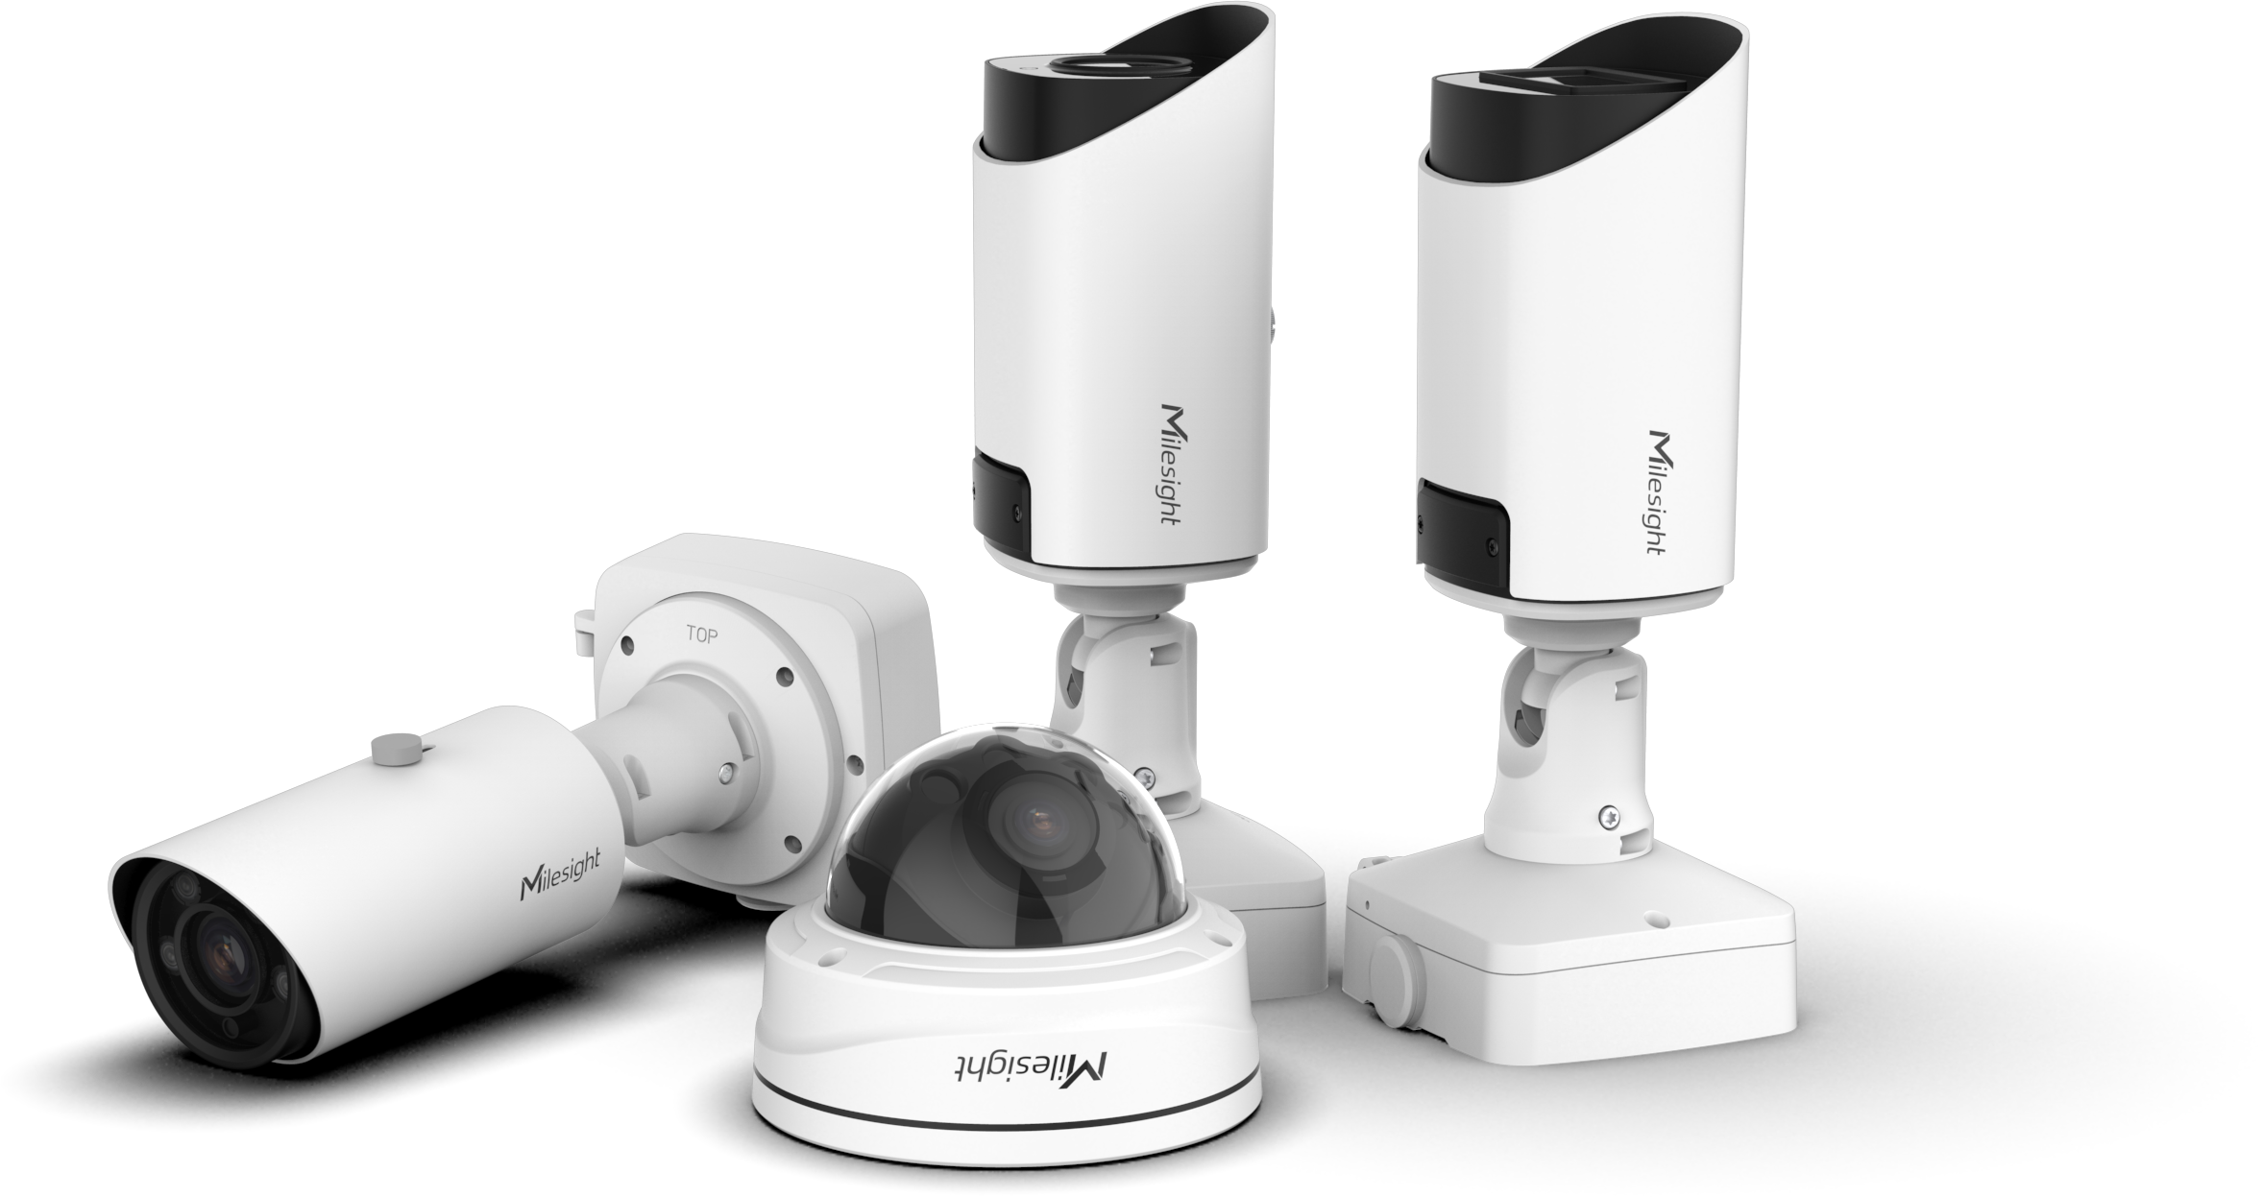
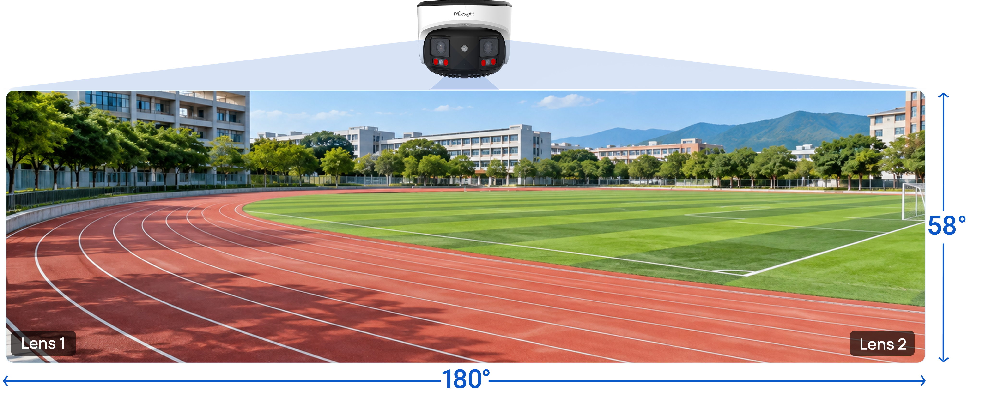












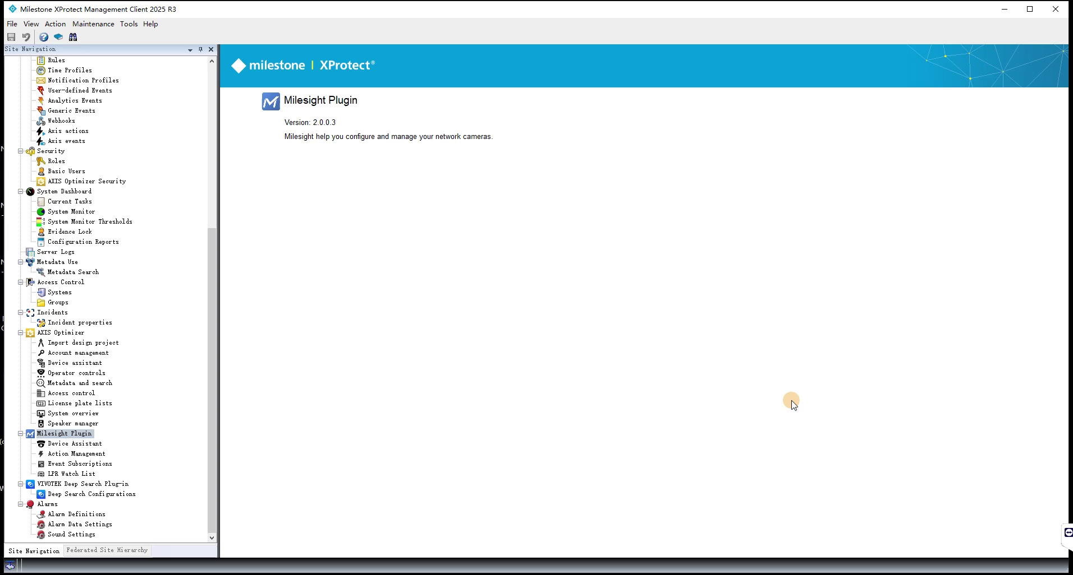



Elevating Security Across the Campus
Challenges
Wide-Area Coverage for Open Areas
Safety Incidents
Large-Scale Coverage
Unauthorized Access
180° panoramic coverage minimizes blind spots & camera coount
Auto-tracking maintains continuous awareness of moving activity
Deeper Intelligence for Campus Safety
More Use Cases: Address complex safety scenarios
AI-triggered Alerts: Enable timely intervention
Faster Investigation: Locate people quickly with attribute search
Unify Campus Security with XProtect
Centralized Security Operations: Manage cameras, events & alarms across the entire campus
Smarter Access Control at Every Entry
Role-Based Permissions: Give each user access only to the cameras and functions they need
>98% ANPR accuracy for reliable vehicle identification
Up to 72° recognition for greater installation flexibility
Video + IoT Intelligence: Extend campus awareness beyond video (e.g., fire & smoke, IAQ sensors)
Allowlist & blocklist for automated access control (up to 100,000 records)
Notes:
校园核心挑战：环境复杂性，不仅是“看见”，而是如何在不同区域实现 更早识别风险、更高效完成覆盖、更精准管理出入，并最终将这些分散的能力形成统一的完整解决方案。
因此按照 “Detect → Cover → Control → Unify” 四层逻辑展开：
1. Detect：“Detect Earlier. Respond Faster.” 首先解决最核心的人员安全问题。这里不以单纯罗列 AI Events 为重点，从基础目标检测进一步延伸至复杂事件、行为和属性分析。体现 AI 不仅能覆盖更多校园安全场景，也能贯穿从事件识别、及时介入到后续调查的完整流程。
2. Cover: 进一步解决校园面积大、开放区域多带来的覆盖效率问题。
3. Control: 校园车辆出入口 & 名单管理。
4. Unify：前三部分解决的是不同区域的具体需求，但 Campus 项目最终会产生大量 cameras、AI events、alarms 和不同用户角色，因此最后自然引出 Milestone，统一管理，

Slide 16











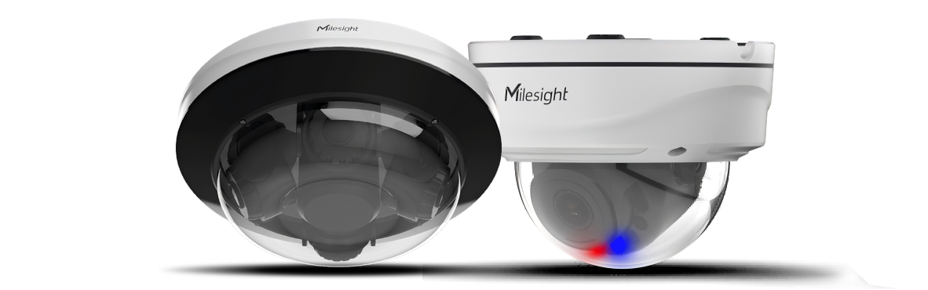

Comprehensive Security for Mining Sites
Long-Range Protection for Remote Perimeters
Challenges
Worker Safety
Asset Theft
Remote Perimeters
See Further: 42X optical zoom & 300m IR for day & night visibility
Detect Accurately: Advanced analytics with fewer false alarms & less operator workload
Proactive Safety for High-Risk Operations
Track Continuously: Auto-track suspicious targets to capture critical evidence
Worker Safety Anyatics: Detect PPE violations, falls & unsafe behaviors
₊
Faster Investigation: Narrow down relevant footage with attribute search
Mining Operations with XProtect
Built for Harsh Sites: Reduce downtime & field maintenance
IP 67
IK 10
-40 - 60°C
working temp
Unified Site Awareness: Bring safety, asset & perimeter events into one view
High-Value Asset Protection
Actionable Intelligence: Turn critical events into coordinated response workflows
Efficient Coverage: Cover complex storage areas with fewer devices
Flexible Deployment: Adapt to diverse layouts with purpose-built camera form factors
Remote Operations: Maintain visibility & control across distributed mining areas
Active Deterrence: Red & blue lights to deter theft before losses occur
Notes:
围绕矿区最典型的风险和痛点: 人员安全、资产保护、便捷防护，基本覆盖了一个 mining site 最核心的安防对象。
Worker Safety 重点不是普通视频监控，而是把视频能力进一步延伸到高危作业安全。
“安全”转向“防损”，矿区仓储和设备区域结构复杂，所以这里不靠单一产品，而是通过不同 camera form factors 提高覆盖效率和部署灵活性。这里实际上体现的是 Milesight 产品组合对 SI 做方案设计的灵活性。
边界防护（范围大、距离远、夜间和偏远区域难用人工持续监控）。所以逻辑是非常明确的 “看得远-看得准-持续跟踪”。这里给 SI 的核心价值是用更高效的方式解决大范围 perimeter protection，而不是简单增加更多 camera points。

Slide 17





Why Choose Milesight?
More Support to Win Projects
Project-Specific Flexibility
Demo & PoC Testing
Project Registration & Special Pricing
SPIFF Sales Incentives
Flexible Product & Feature Customization
Milesight-Developed & Maintained Plugin
Updated with New Products & XProtect Releases
Stronger Project Economics
Technical Support at Every Stage
30–40% Hardware Margin Potential
0.5% defect rate — Fewer RMAs & Service Costs
Pre-Sales Training & Solution Design
Post-Sales Technical Support
On-Site Support for Critical Projects
Make Sensing Matter
Notes:
前面整套 PPT 都在回答 “Milesight 能做什么”，最后这一页应该回答 SI 最现实的问题：“Why should I actually choose Milesight for my next Milestone project?”
所以这里不再讲 前面已经证明过的东西，而应该完全切换到 SI 做项目时真正关心的价值。
商业层面，项目和利润有保护
技术层面，特殊项目需求我们能配合
维护层面，Plugin 我们自己开发 → 我们自己持续维护 → 新产品 / XProtect 更新我们跟 → SI 少做 integration work
竞争力层面/经济价值，在可靠品质基础上提供更大的margin。对标中高端的hanwha/axis，需要找业务提供项目利润对比作为数据支撑，让 SI 看到 Milesight 不仅在技术上能满足项目，也能让项目在商业上更有竞争力。这个数据要根据对象，比如说代理还是SI，在话术上灵活调整。

Slide 18
04 Incentive Program
Make Sensing Matter

Slide 19

Incentive Program
Title1 | Title2 | Title3 | Title4 | Title5 | ...
Main information | Main information | Main informationMain informationMain information | - | Main information | -
Main information | Main information | Main informationMain informationMain information | √ | Main information | -
Main information | Main information | Main informationMain informationMain information | √ | Main information | -
Main information | Main information | Main informationMain informationMain information | √ | Main information | -
Make Sensing Matter

Slide 20




THANK YOU
www.milesight.com
Building C09, Software Park Phase III,Xiamen 361024, Fujian, China
Make Sensing Matter

